Slide 1
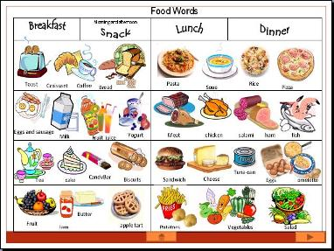
Eating Great Britan
Notes:
The food in great britan is variety tipe: breakfast, full breakfast; lunch, packed lunch, Sunday dinner, dinner. There are 4 moments that all day which the people british eat. Now we going to see in detail.

Slide 2
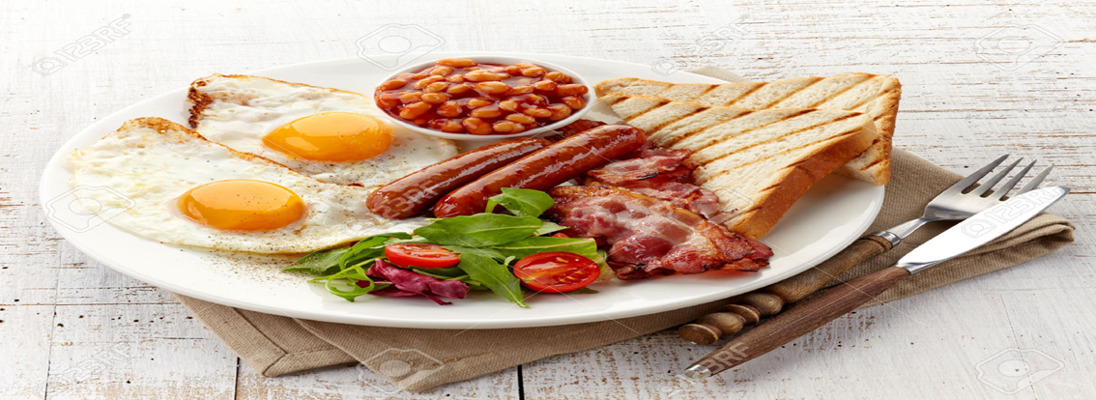
The breakfast
Breakfast
food
when
drinks
where
Notes:
The breakfast in Great Britan for food consists of: bacon, sausage, eggs and a variety of other cooked foods, with a beverage such as coffee or tea. The people british do breakfast at home

Slide 3
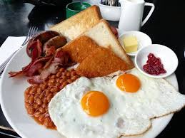
Full english breakfast
Full english
Breakfast
food
When
Drinks
Where
Notes:
The full breakfast is a breakfast meal usually including bacon,sausages,eggs, and a variety of other cooked foods, with a beverage such as coffee or tea. It is especially popular in the UK and irland, to extent that many cafès and pubs

Slide 4
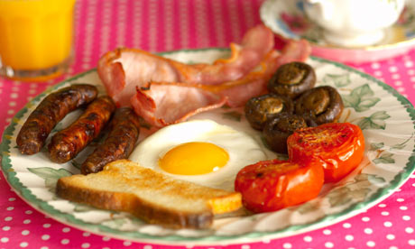
The lunch in great britan
Lunch
food
when
drinks
Where

Slide 5
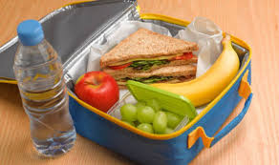
Packed lunch
Packed lunch
when
drink
where
food
Notes:
Very often the people that work didn’t lunch at home then they take the food at work

Slide 6
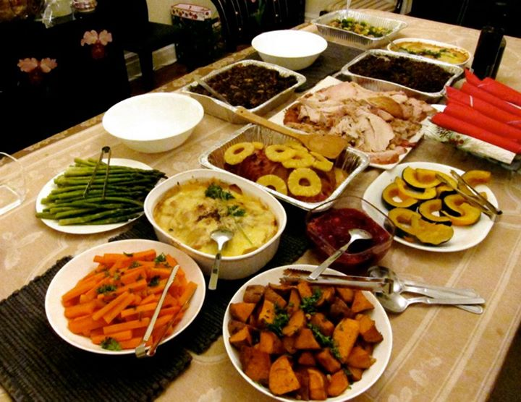
dinner
Dinner
food
when
drinks
Where

Slide 7
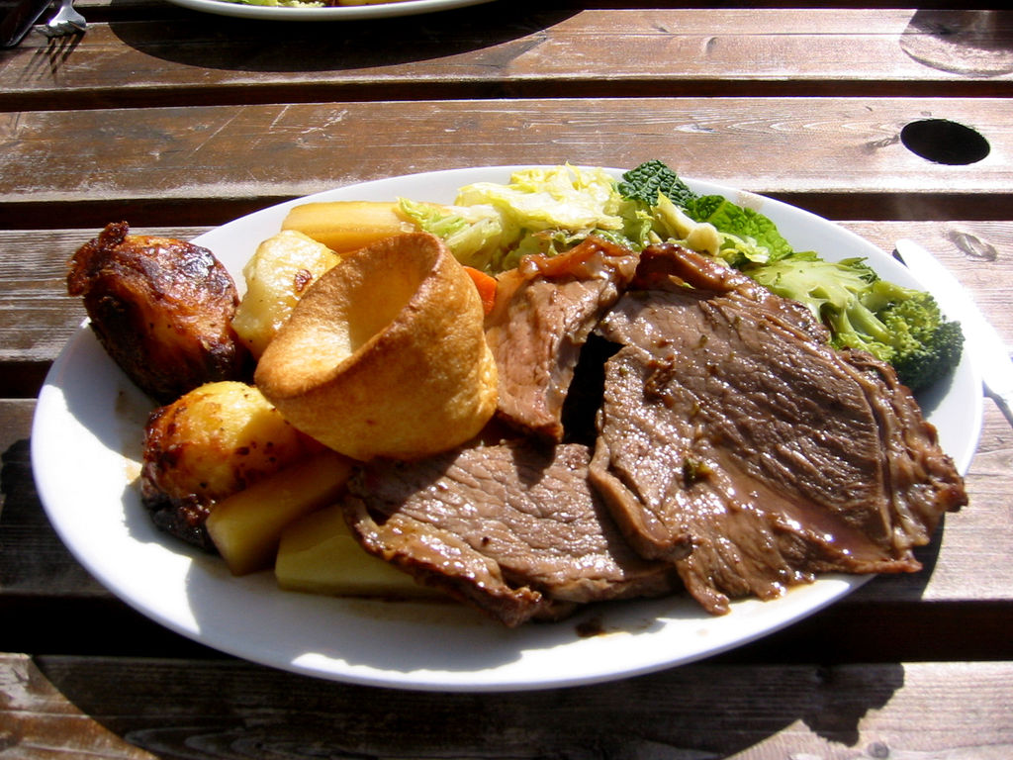
Sunday dinner
Sunday dinner
food
when
drinks
where

